Slide 1

Customer Shopping Behavior Analysis
Uncovering insights from 3,900 purchases to guide strategic business decisions

Slide 2

DATASET OVERVIEW
The Foundation
3,900
18
50
Total Purchases
Data Features
Locations
Key Data Points
Customer demographics & purchase history
Product details across 4 categories
Shopping behavior & review ratings
Subscription & shipping preferences

Slide 3

PHASE 1
Data Preparation in Python
01
Data Loading & Exploration
Imported dataset, checked structure and summary statistics
02
Cleaning & Standardization
Handled 37 missing values, renamed columns to snake case
03
Feature Engineering
Created age groups and purchase frequency metrics
04
Database Integration
Connected to PostgreSQL for advanced SQL analysis

Slide 4

PHASE 2
SQL Business Analysis
10 key queries to answer critical business questions
Revenue by gender comparison
High-spending discount users
Top-rated products analysis
Shipping type preferences
Subscriber vs non-subscriber behavior
Customer segmentation patterns

Slide 5
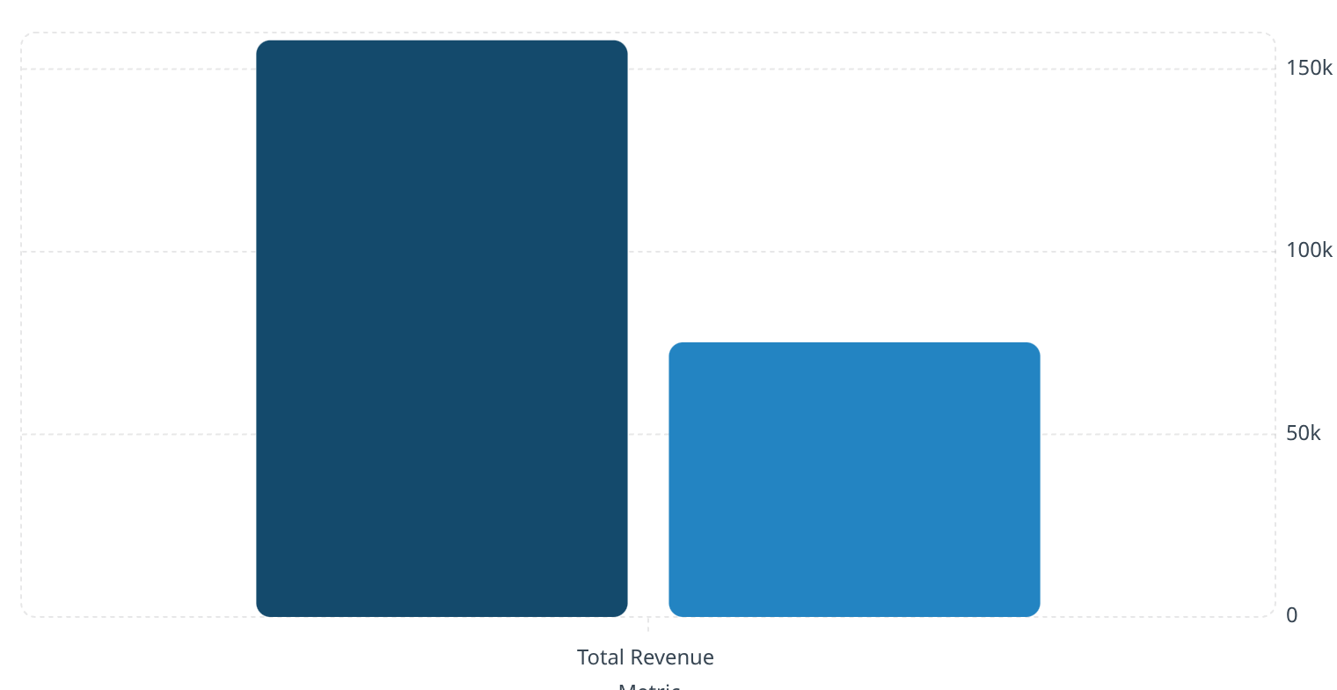
Revenue Insights
Male
Female
Gender Revenue Gap
Male customers generate 2.1x more revenue than female customers
Opportunity to boost female customer engagement through targeted campaigns

Slide 6



Subscription Status Analysis
Subscribers
Non-Subscribers
1,053 customers
2,847 customers
$59.49 avg spend
$59.87 avg spend
$62,645 total revenue
$170,436 total revenue
Only 27% of customers subscribe, yet spending patterns are similar—huge growth opportunity

Slide 7



Customer Segmentation
New
1
83
Returning
2
701
Loyal
3
3,116
80% of customers are loyal, indicating strong retention but limited new customer acquisition

Slide 8
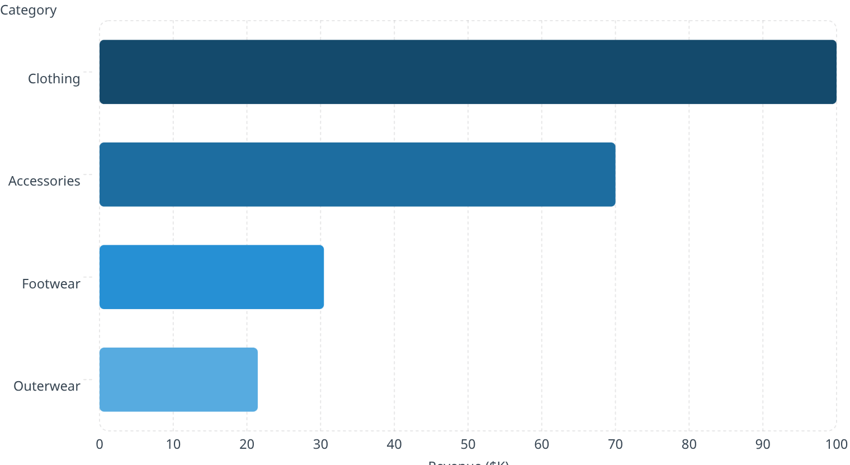
TOP PERFORMERS
Product Performance
Highest-Rated Products
Revenue by Category
Gloves
Sandals
3.86 rating
3.84 rating
Boots
3.82 rating

Slide 9
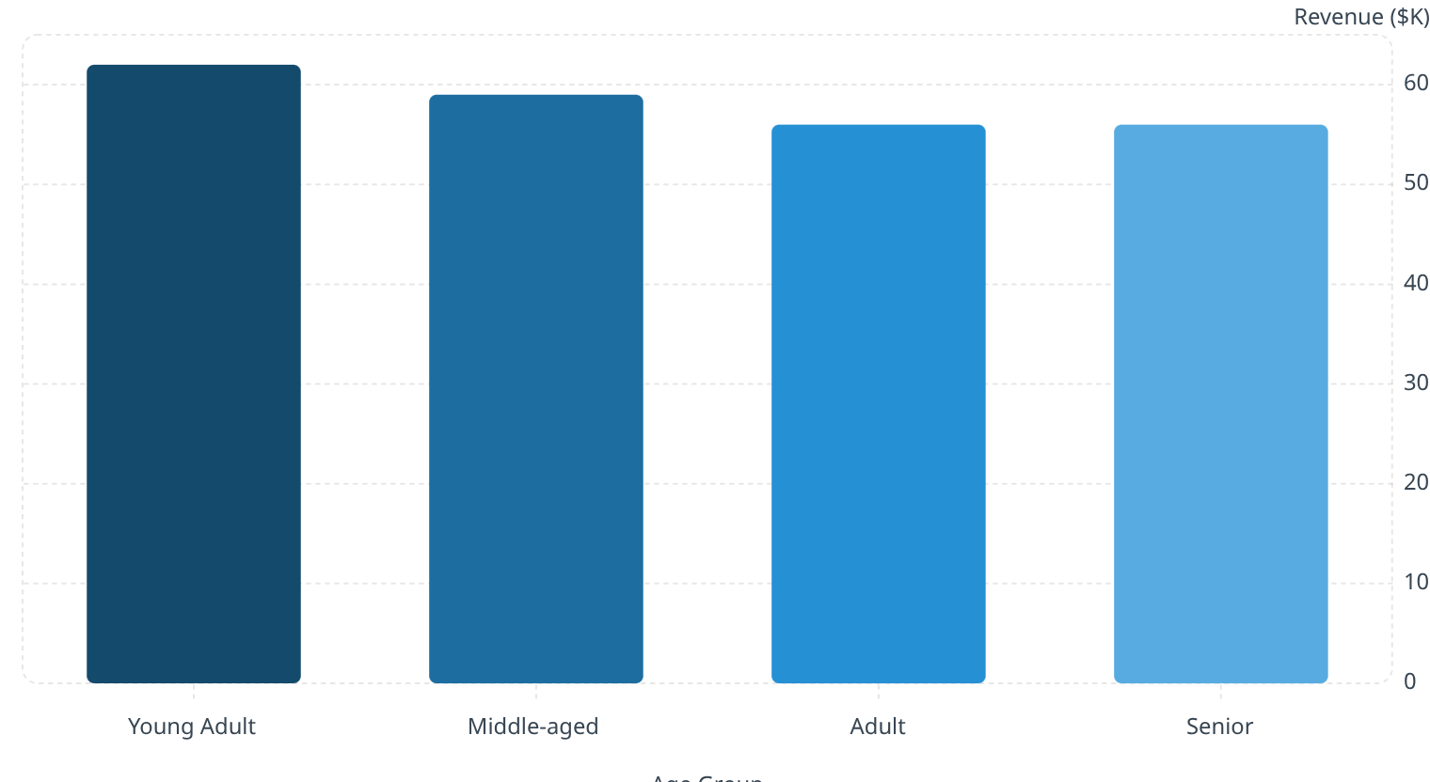
Age Group Revenue Distribution
Key Insight
Young adults lead revenue generation with relatively balanced distribution across all age groups
Consistent spending patterns suggest broad market appeal

Slide 10
ACTION PLAN
Strategic Recommendations
Boost Subscriptions
Loyalty Programs
Review Discount Policy
Product Positioning
Reward repeat buyers to strengthen the 80% loyal base
Highlight top-rated items like Gloves and Sandals in campaigns
Promote exclusive benefits—only 27% currently subscribe
Balance sales boosts with margin control for profitability
Targeted Marketing
Focus on high-revenue young adults and express shipping users

